Slide 1
Maximizing Efficiency and Accuracy: Strategies for Effective Use of Finance Systems in Streamlined Reporting
Session 31
Presented by Bernard Mostert

Slide 2
How do you maximize efficiency and accuracy in financial reporting by using functionality that exists in the system?
https://8allocate.com/blog/the-future-of-software-engineering-predictions-for-2024/
Notes:
The title of the session says - Maximizing Efficiency and Accuracy: Strategies for Effective Use of Finance Systems in Streamlined Reporting, But what does this mean?
OK,
I spoke to my colleagues that deal with user support and consultation to identify common challenges from the users of the system. Maybe I should say, where they are NOT using the system, but opting to do a manual process. , data silos, and the demand for specific information. By the end of the session, attendees will be equipped to utilize the system more effectively, enabling smarter decision-making and improved processes.

Slide 3
Cover the following financial modules:
Student Debtors
Accounts receivable
Cash book
Procurement management
General ledger
Notes:
In the session I will be addressing the following modules in the standard ITS Integrator system.

Slide 4
Student debtors
https://economichardship.org/2022/06/why-canceling-student-debt-should-be-a-universal-benefit/

Slide 5
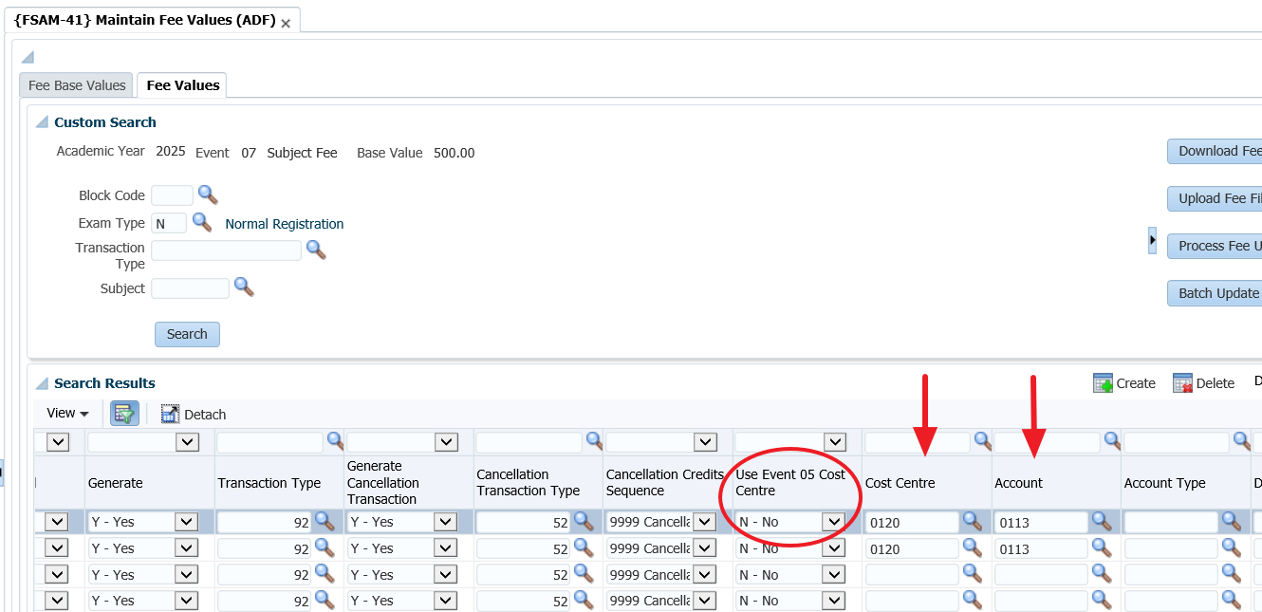
Student debtors – revenue allocation for fees
Notes:
Have you had one of these questions:
What accounts is the system going to debit?
Where will the revenue go?
I want to allocate the revenue to the relevant department
Let’s work from the assumption you raise fees per subject – using event 07. Looking first at the revenue portion – where you are NOT allocating it in a single CC and/or account combination.
Remember that you can decide to allocate revenue per subject – where you complete the CC code, or flag the field “Use Event 05” as Y to use the specific qualification’s CC.

Slide 6
Student debtors – revenue allocation for fees (continue)
Once data is recorded in the GL
Transactions per type report – {FGLOR1-21}. Can do pivot tables.
Easily ID “issues” or incorrect fee set up.
Notes:
Once you have allocated the revenue per CC or account or GLA, the stard GL reports can be used.
Remember the TT report can be generated as a CSV file. You can then import to Excel and do the Powe Pivots. Very easy to immediately detect incorrect CC or accounts that were linked to the fees. For example if there are CC’s with a debit balance, maybe someone did journals… or a CC with fees, where it is not supposed to have.

Slide 7
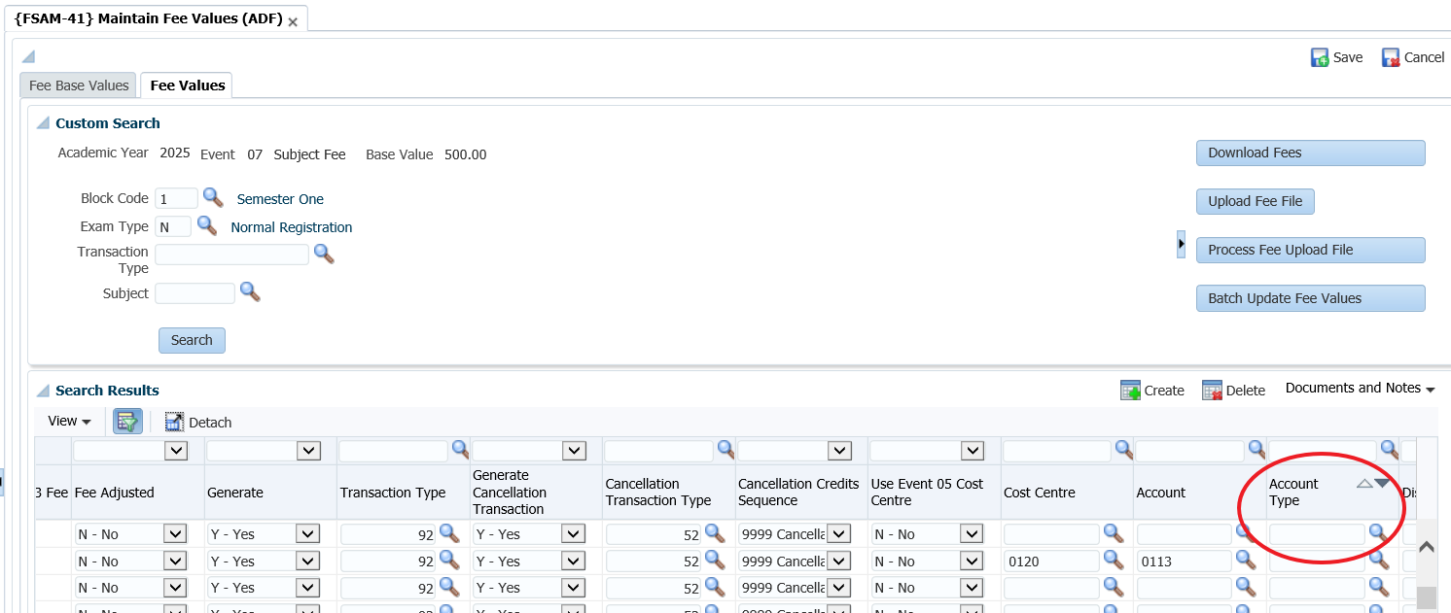
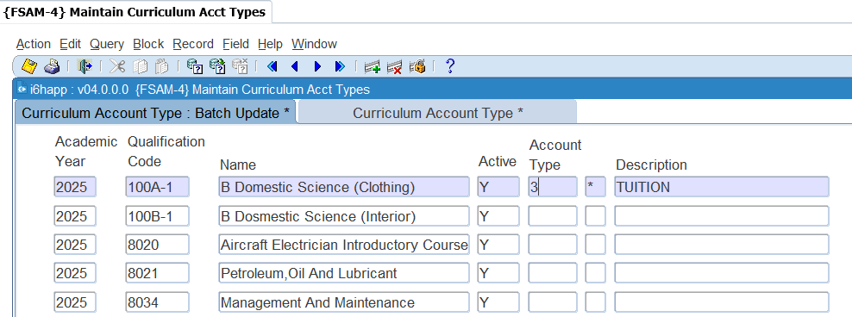
Student debtors – debt allocation for fees, multiple account types
Notes:
Let’s work from the assumption you raise fees per subject – using event 07.
How do “split” the debt? How do you make sure not all the fees raised goes to a single account type?

Slide 8
Student debtors – outstanding debt
Looking at student debt, there are a number of reports available:
{FSAOR2-4} – total debit/credit
{FSAOR2-25} – balances/ageing
FSAOR2-31} – ageing per year **
{FSAOR2-32} – fees raised per year
Notes:
There are a number of standard reports available –
The ageing in option 31 I will explain in the next section.

Slide 9
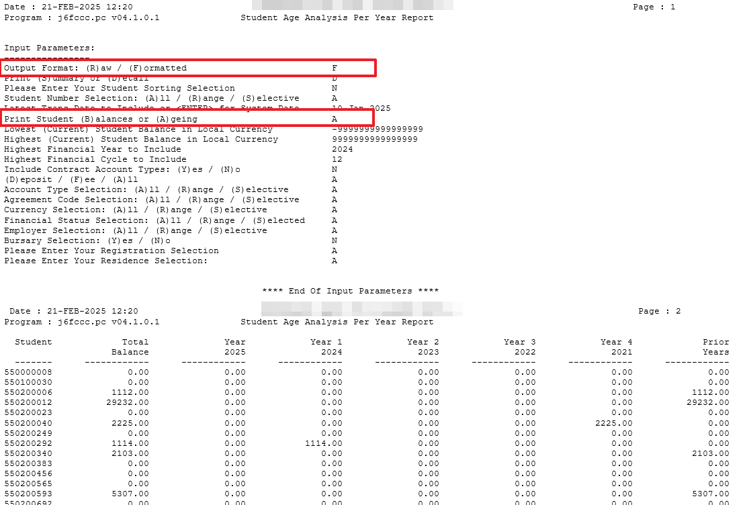
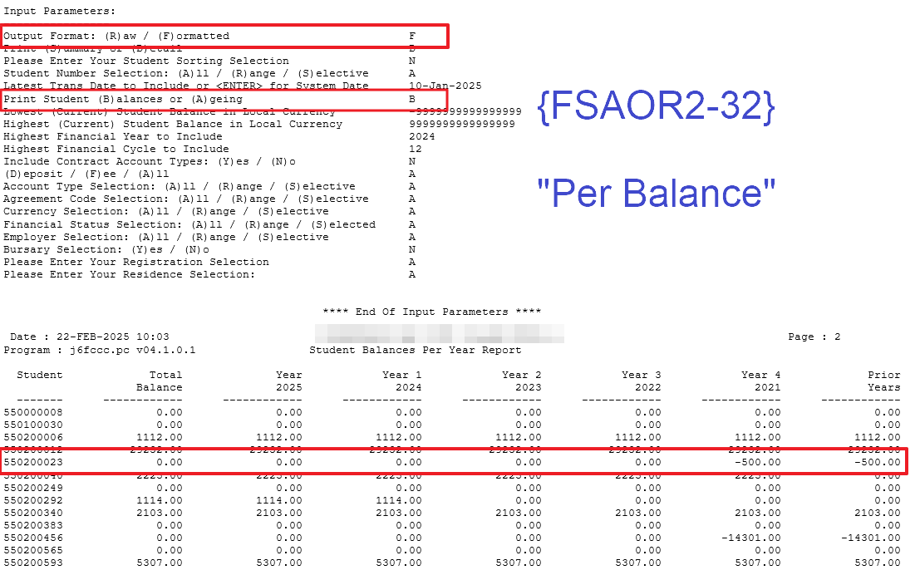
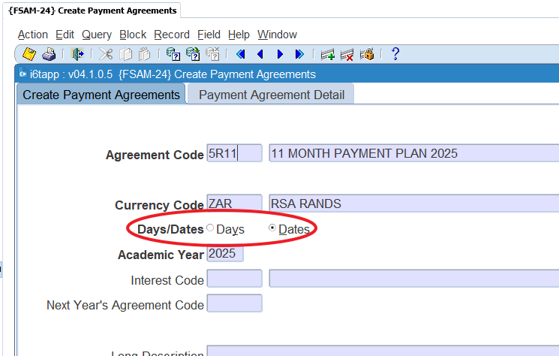
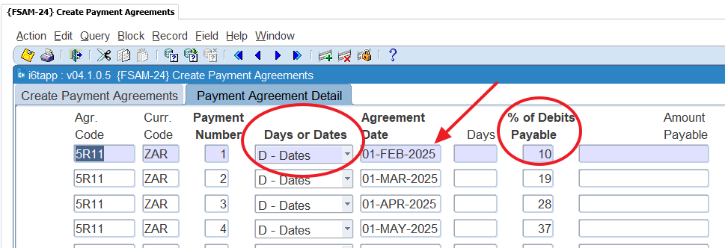
Student debtors – age analysis
Student debtors ageing
On payment agreement – not transaction date
How does it work?
Defined in {FSAM-24} – amount or %, days or date
{FSAM-25} – NB there are two tabs.
{FCSM-1} – look at cash and terms, this and next year
{FSAOR2-31}
Notes:
If you look at the ageing of student debt, you need to understand how it is defined and then how the system is using it.
Pay attention to the use of the 1st day of the month, instead of the last. It all depends on your process…
Also remember that the system is using this when the distribution of the default account type takes place. We will get to that in the next slides, but it important to understand first how the age analysis is working.

Slide 10
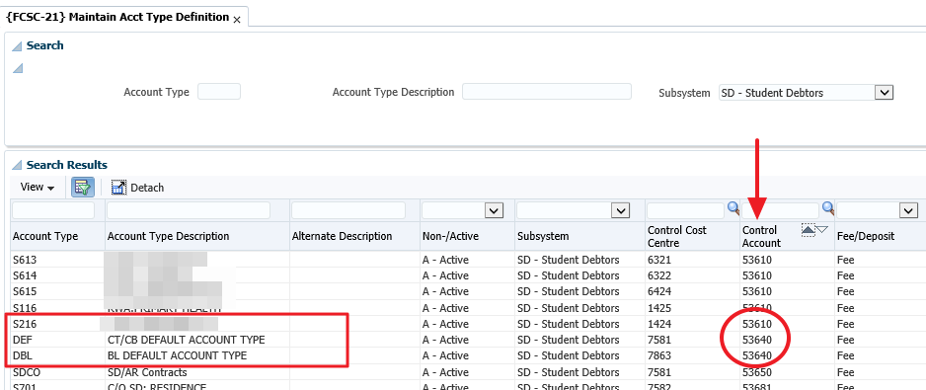
Student debtors – default account type
Reporting on students with debit and those with credit balances
Do you show on your reconciliations – or is it combined debt?
How does the distribution work?
The dates of the agreement
Then codes
Look at the GLA’s that are linked to the account types for SD
Notes:
It is important to note that the distribution of the default account type is looking at the payment agreement of the transaction, BUT if they are the same, we are looking at the code…
You can’t have the default and the other SD account types having the same account.

Slide 11
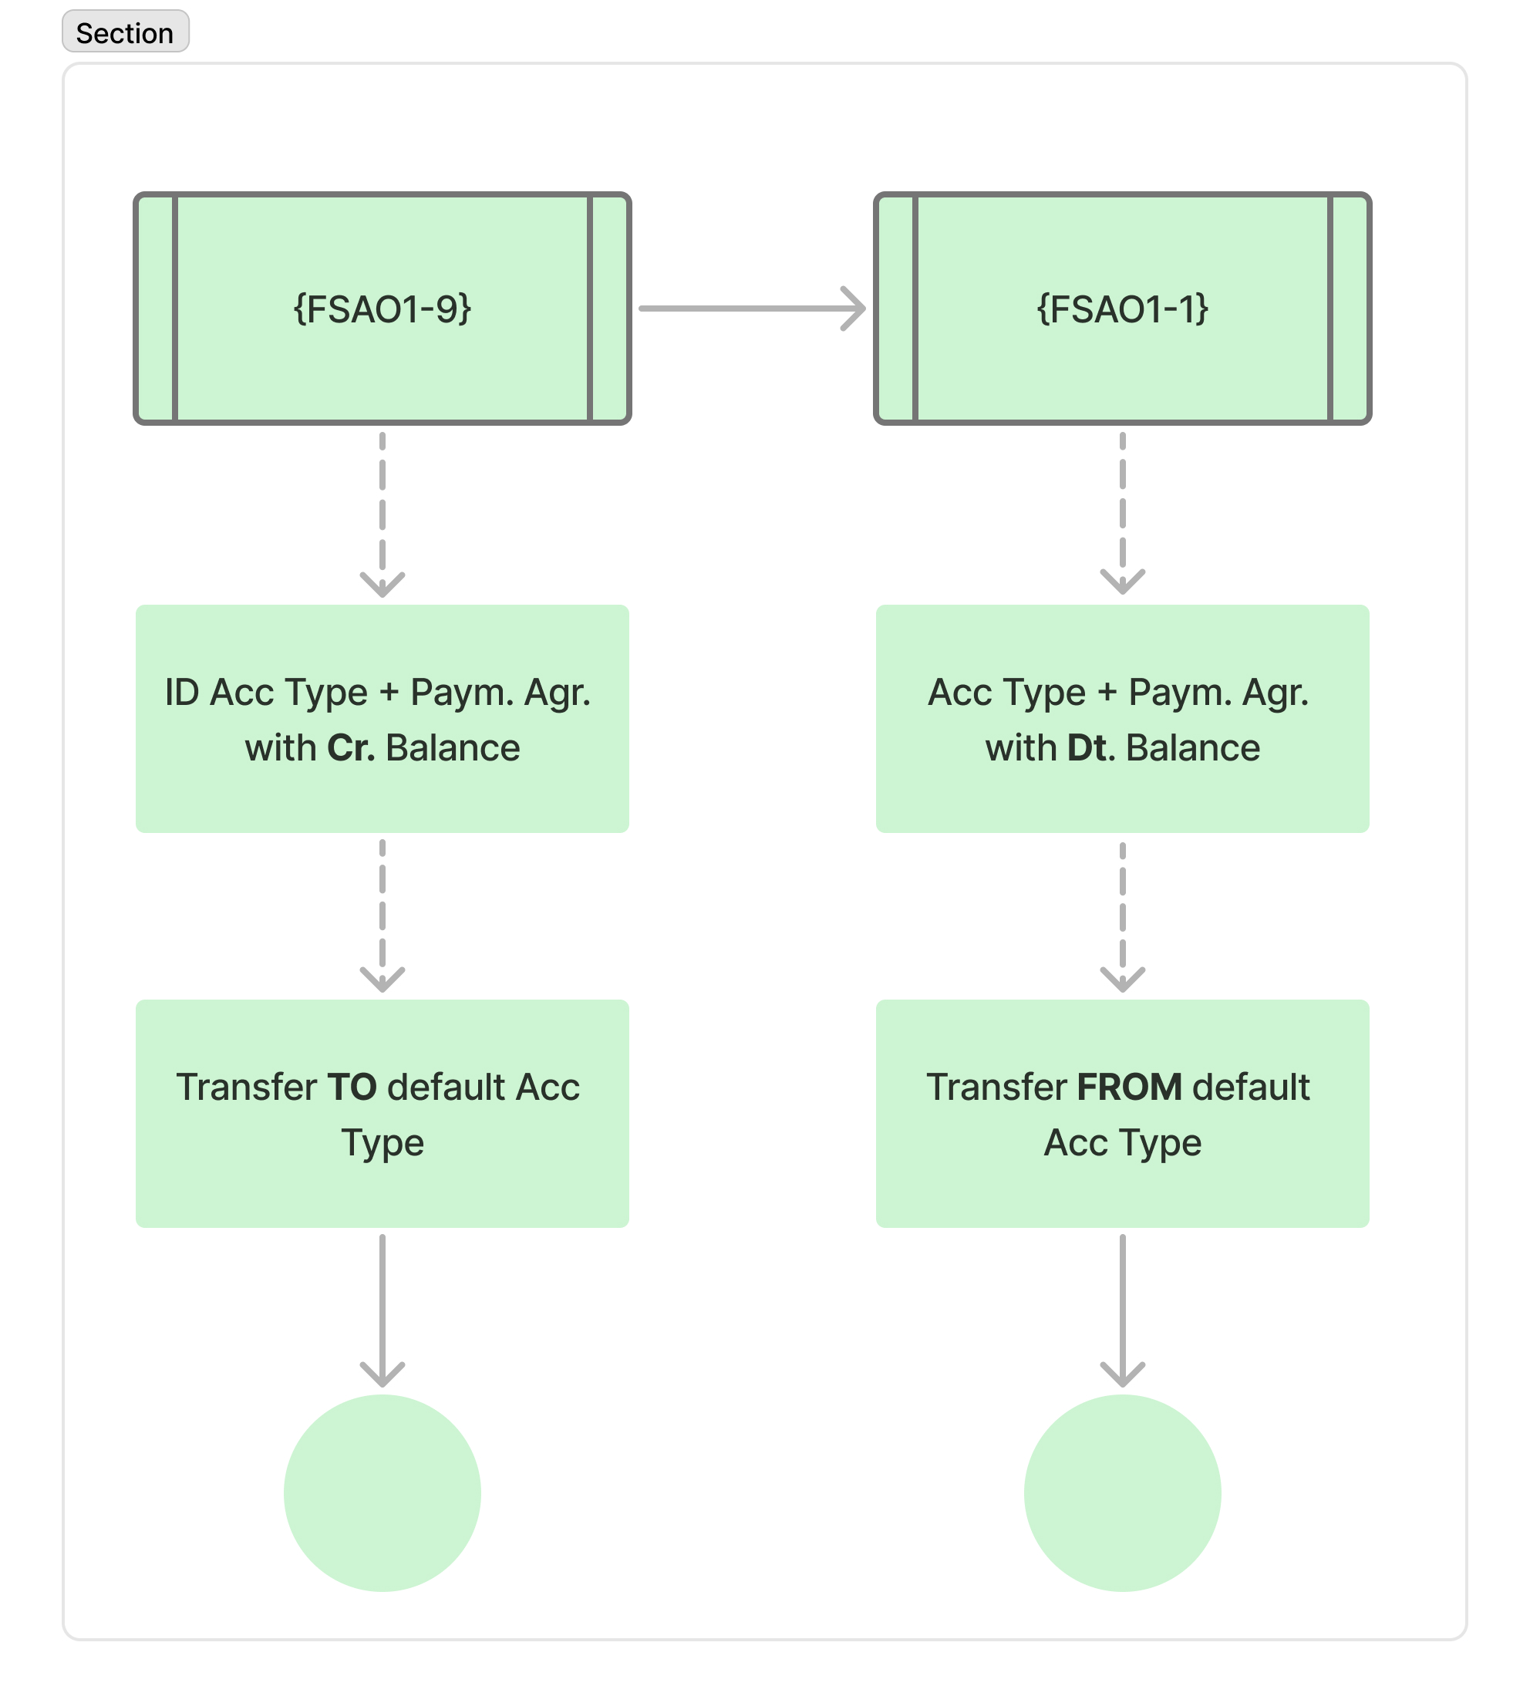
Student debtors – default account type (continue)
Important to schedule the distribution
Notes:
If you don’t schedule it, you run the risk to forget to do this, which results in a student that have a credit on a specific account type agreement combination, while they have a total outstanding balance.
I need to explain what will happen when the options are executed.
Now if you didn’t do the distribution, your age analysis report in {FSAOR2-25} will look like this:

Slide 12
Accounts Receivable
https://pix4free.org/photo/33427/accounts-receivable.html

Slide 13
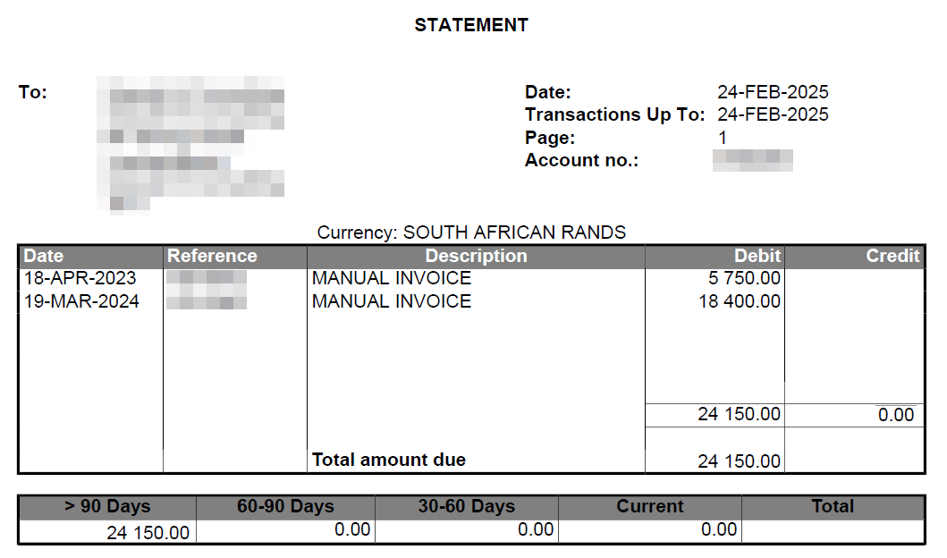
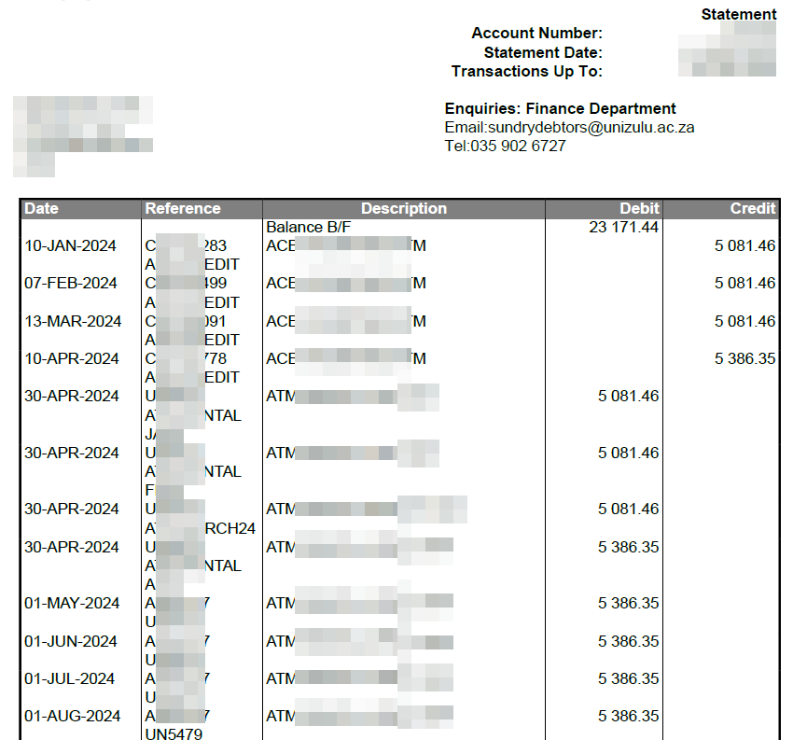
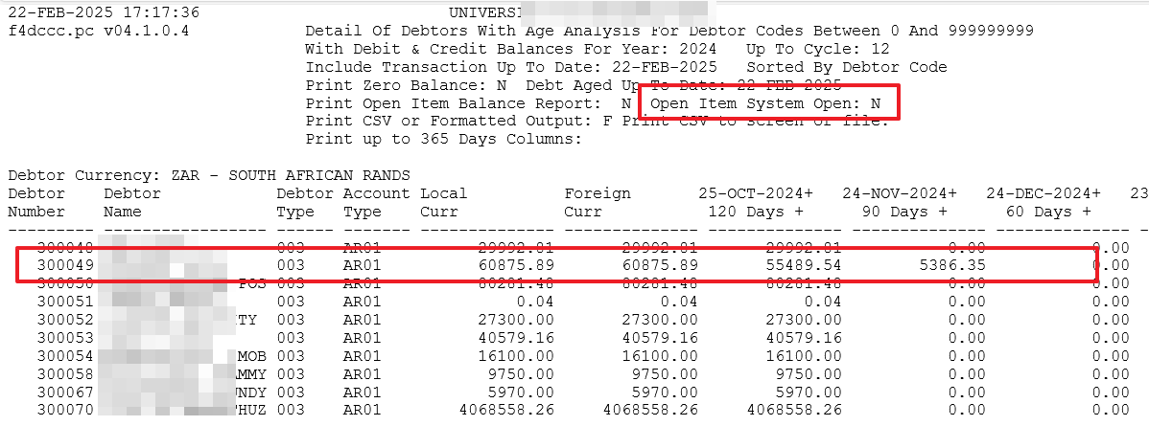
Sundry debtors – age analysis
With sundry debtors you have the “Open Item” functionality
Improved statements
Better age analysis – not off the oldest debt
Notes:
With open item it adds to a more professional reporting.
You will see with the statement, we are not just showing the list of transactions, but the invoices that are still outstanding – remember when you are not using the open item functionality the system takes payments of the oldest invoices… where the ageing is done on those items.

Slide 14
Cash Book
https://reicashflows.com/

Slide 15
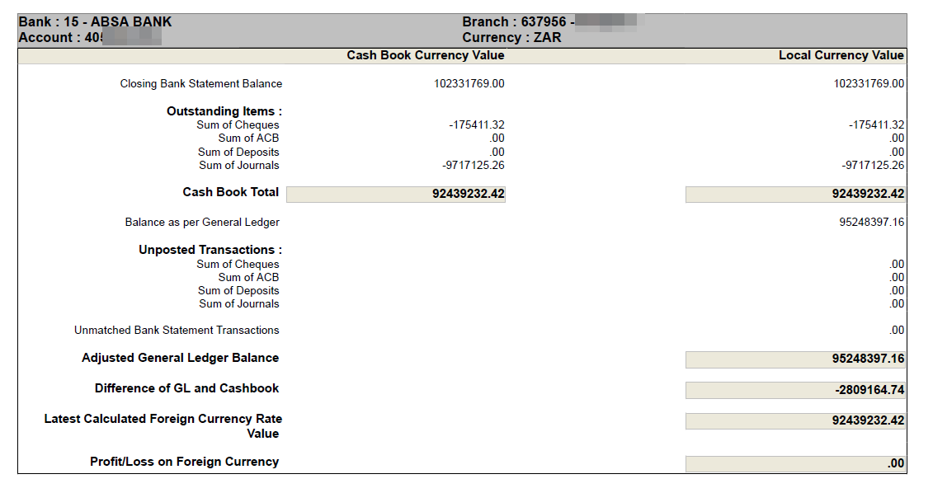
Cash Book - Reconciliations
Bank (cash book) reconciliations:
Are you uploading transactions?
Host-to-Host?
What reports are you using?
{FCBOR1-2} – Bank reconciliation
{FCBOR1-10} – Bank recon at a specific date
{FCBOR1-11} – Bank recon detail
Notes:
I know we communicated this, but I also know we are creatures of habit.
How many of you are only using option 1 and not 10?
Let’s look at the difference.

Slide 16
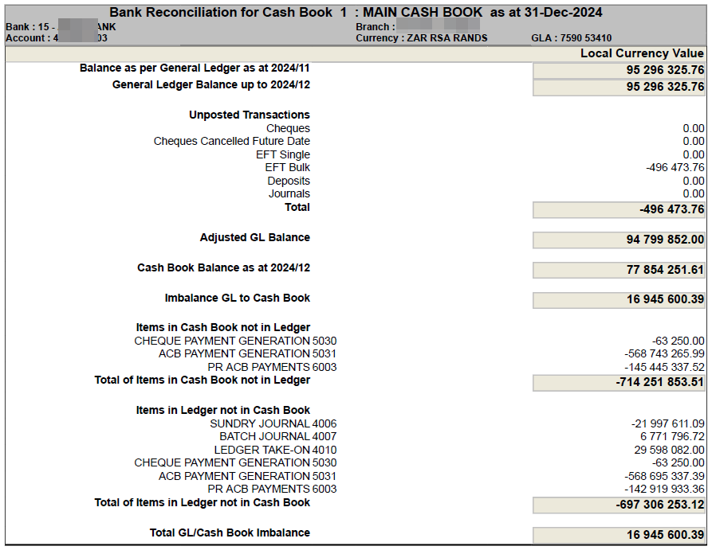
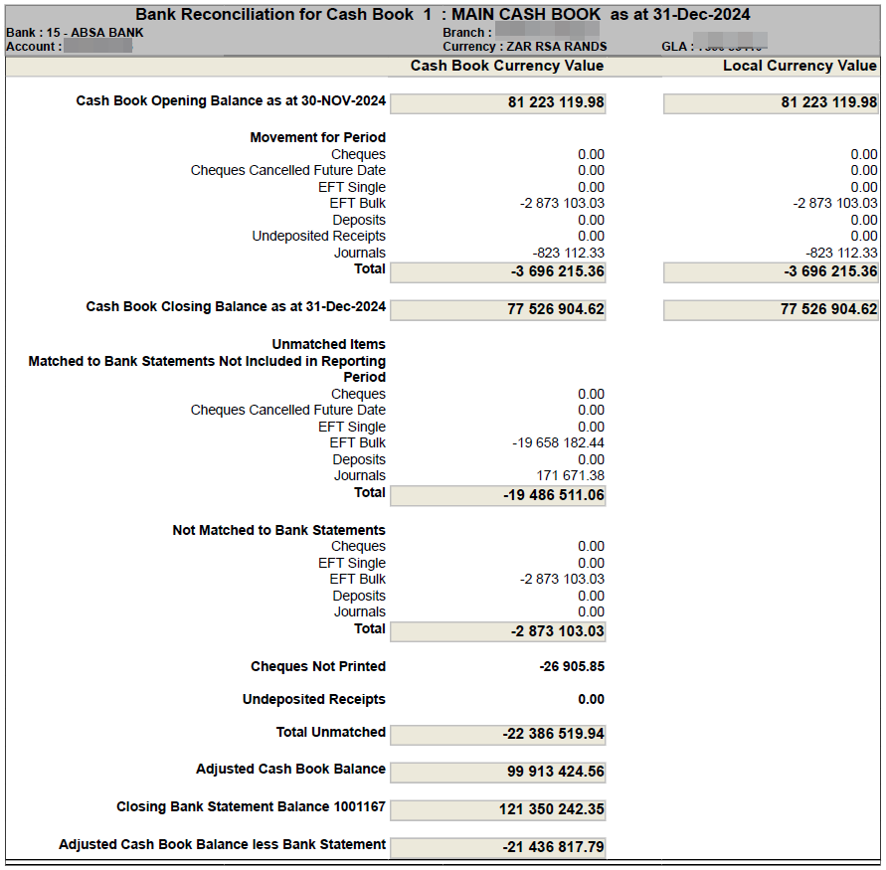
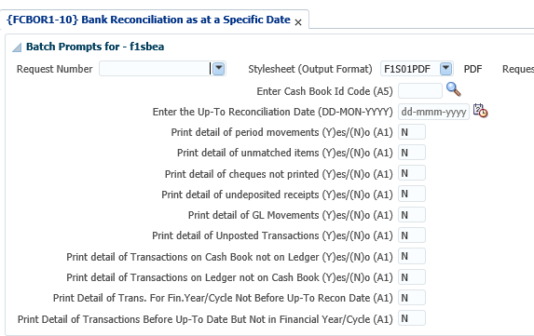
Cash Book – reconciliations (continue)
FCBOR1-10 has a few parameters:
Notes:
Looking at the option 10, there are a few parameters.
Please don’t just enter/tab through them, read what it asks. It may assist when you are looking for differences.

Slide 17
Procurement Management
https://reicashflows.com/

Slide 18
Procurement Management – “Common” queries
My budget is not correct
The age analysis of my creditors are incorrect
The cashflow report is incorrect
Notes:
Any of these “comments” sounds familiar?

Slide 19
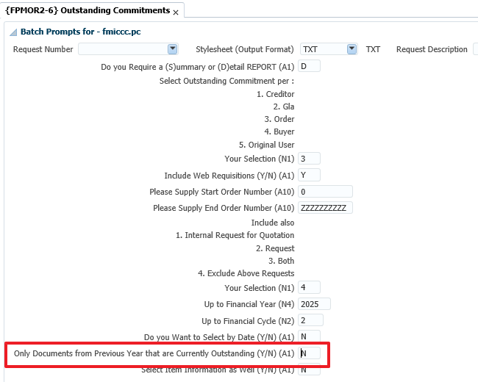
Procurement Management – incorrect budget
The majority of you knows about {FPMOR2-6}, “Outstanding commitments”
What about {FPMOR2-4}? “Documents status”
Notes:
Everyone should know about the commitments report, but I am not sure everyone uses the relevant parameters…
Remember that all commitments are carried forward… if you want to see the “old” commitments, make use of the parameter “Previous years”
If you are using the accruals functionality, it is not an issue, but remember to also look at the report in option 4.

Slide 20
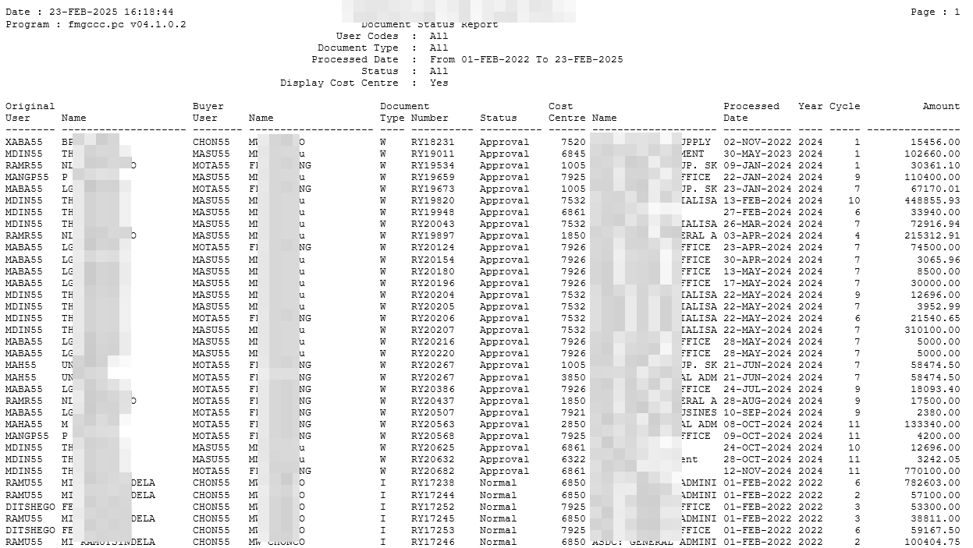
Procurement Management – {FPMOR2-4}
When executing the report, the report will provide details of documents that are in:
“Approval” – impacts budget
“Normal” – impacts budget
“Processing”
“Verify” – impacts budget
Notes:
Any of these “comments” sounds familiar?

Slide 21
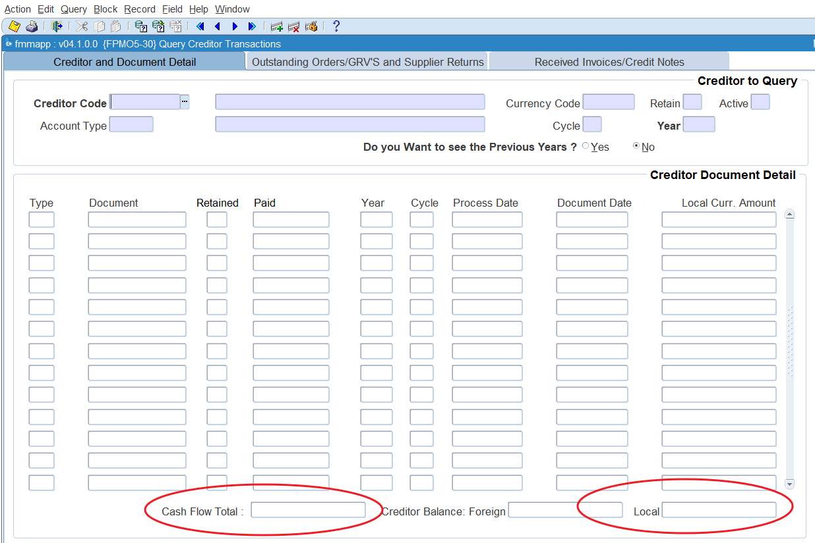
Procurement Management – incorrect cash flow
Important to remember that there are a few “basic” things that has an impact on cash flow on your creditors.
Payments “outside” of the system
Retain invoices
Notes:
Let me explain what I mean about the cash flow and balance… as this impact also the age analysis.
For those who are not sure what I am referring to, here is a screen that will refresh the memory

Slide 22
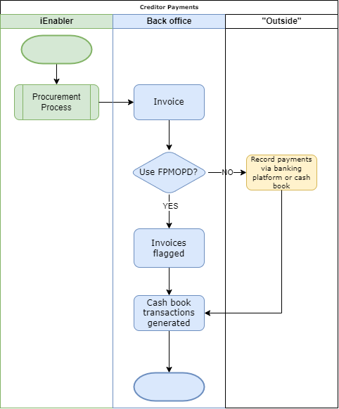
Procurement Management – payments outside the system
Notes:
Here is a basic flow diagram of what we see is happening…

Slide 23
Procurement management – retain invoices
What happens when you retain an invoice?
Excluded from payment in {FPMOPD}
What is it NOT doing?
Change the balance of the creditor, or GL.
Notes:
Colleagues, please remember these comments – it impacts your reporting, as simple as this sounds… I have noticed over the last 6 months we get too many of these queries.

Slide 24
General Ledger
https://osome.com/sg/guides/what-is-financial-reporting/

Slide 25
General Ledger – what happens with year end?
Year end close – {FGLM-7}
1. Validate General Ledger
2. Clear Rev/Exp Accounts
3. Carry Forward Present Balance Sheet
4. Open Next Fin. Year
Notes:
I had a few questions recently about the year end process and what the system does.
When we look at the option in short there are 4 options, I want to discuss in short what happens and also looking at other parameters that are overlooked.

Slide 26
General Ledger – what happens with year end? (step 1)
Let’s look at the details – Validate the ledger:
GL is in cycle 13
GLA’s are complete – valid values
All sub systems are in the next financial year
Validate transfer accounts – accumulated funds
Validate all TT linked to the relevant events – balances carried forward
Test balance of GL
Test GLA’s for next financial year
Notes:
Why am I reminding you about this?
Remember there are validation reports you can execute BEFORE running the year end close. The options:
FCSO-2 – validate CC structure
FCSO-4 – validate account structure
FGLPR1-4 – transactions on invalid GLA’s.
FGLOR1-26 – account summary report, looking at the balance of the GL.

Slide 27
General Ledger – what happens with year end? (step 1 continue)
Account categories – income statement accounts not mixed with balance sheet
Then looking at the answer to the account category 999 question
Notes:
Do everyone know what the question means – the category 999?
Remember that in the case where you have suspense accounts – that should have a zero balance, you can use this.

Slide 28
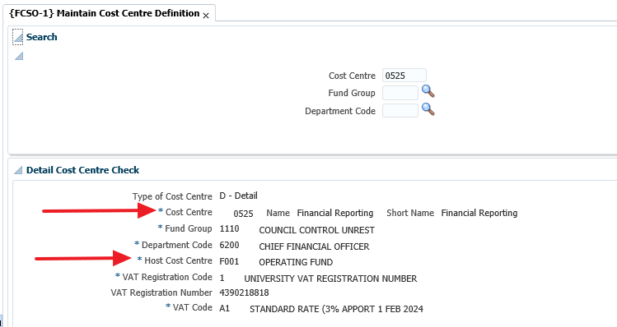
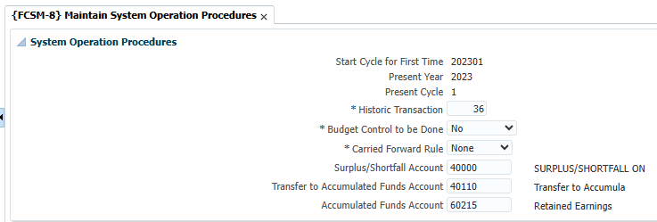
General Ledger – what happens with year end? (step 2)
Let’s look at the details – Clear revenue and expense accounts:
The system DOES NOT INSERT a journal against the income statements accounts
Notes:
Remember if we insert a journal in the income statement account, the result will be a zero balance, that means you can’t look at prior year info, as everything will have zero balances.
We calculate the surplus/shortfall and transfer to the specific CC between the transfer and accumulated funds account. We get the accounts we need to use from the option {FCSM-8}
It is important to also remember that the CC definition plays a big role…

Slide 29
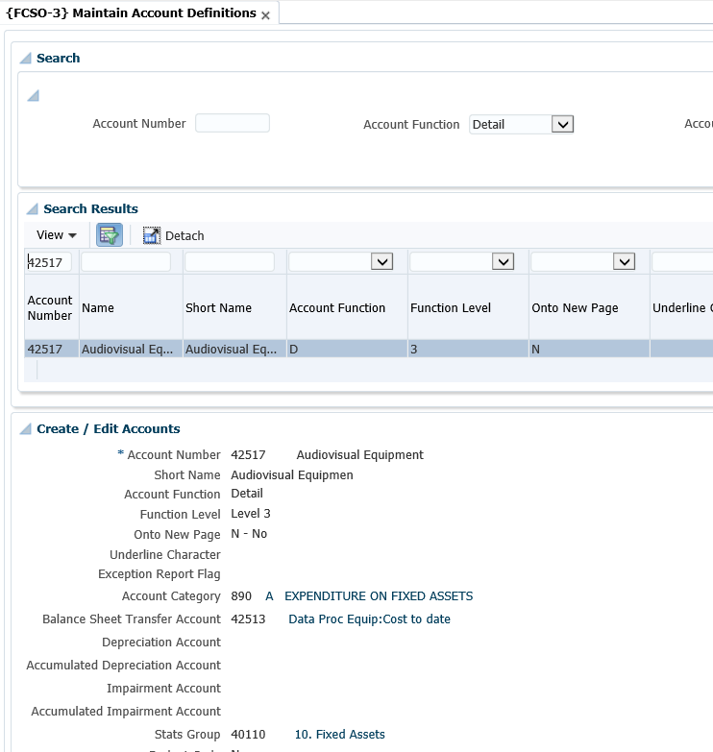
General Ledger – what happens with year end? (step 3)
Let’s look at the details – Carry forward present balance sheet:
Balance is carried forward for the balance sheet accounts – cycle 14
Notes:
There are two things happening when the phase/step 3 option is executed.
It will transfer the balance sheet balances to the next year in cycle 14. You will see in the next slides how you can determine what the opening balance was…
In the previous slide I showed you the HOST CC – this is still relevant when balances are carried forward.
Then it will also transfer balances from the accounts, where you linked the relevant accounts in the definition – think specifically of the asset accounts, BUT it is not limited to this.

Slide 30
General Ledger – what happens with year end?
You can execute up to step 3 as often as you want
Once you execute step 4 – you are done, can’t go back
Notes:
While you are busy with AFS, there is a need to recalculate the opening balances…
Reminder that you can’t have the GL in 2023 and expect to have carry forward balances in 2025.

Slide 31
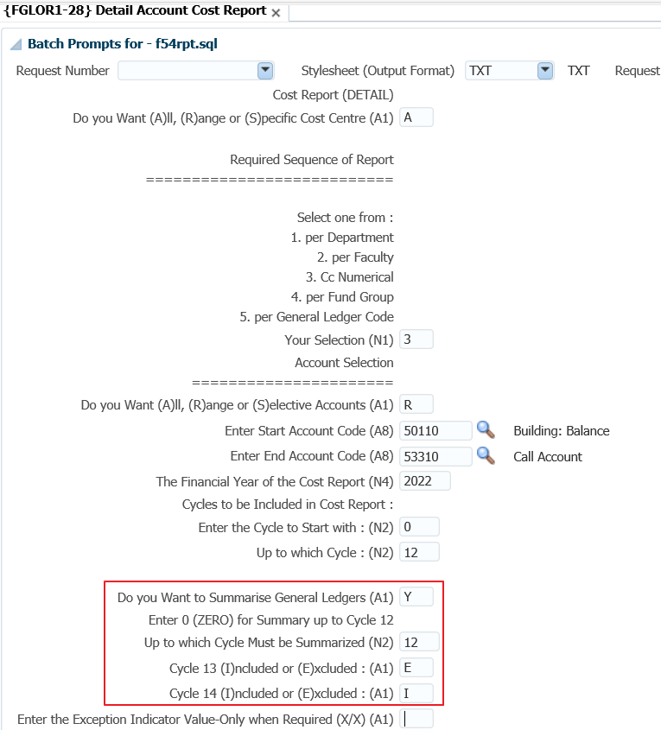
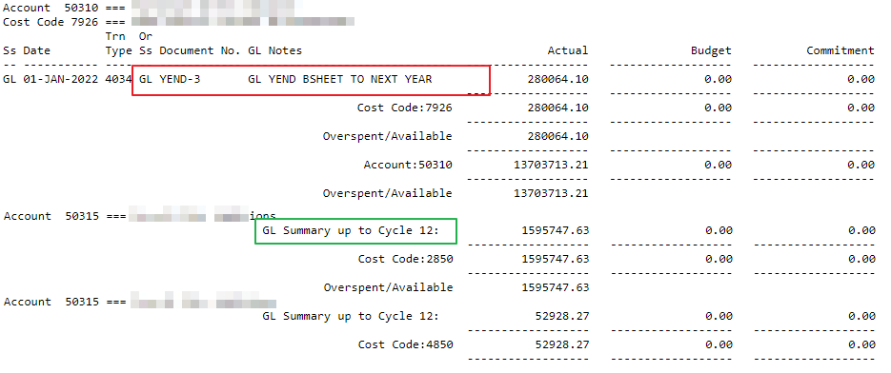
General Ledger – Report parameters
How do you get only the opening balance of a specific account?
Notes:
When you look at the detail report CC or account – {FGLOR1-8/28} you need to pay attention to the parameters:
The section I have blocked…
Those parameters can be explained as follow – summary the important one, while you also need to pay attention to cycle 13 and 14.
The output will have the opening balance and the summary – if there were entries in that financial year will shows summary up to the selected cycle.
Validation of CC structure

